Slide 1
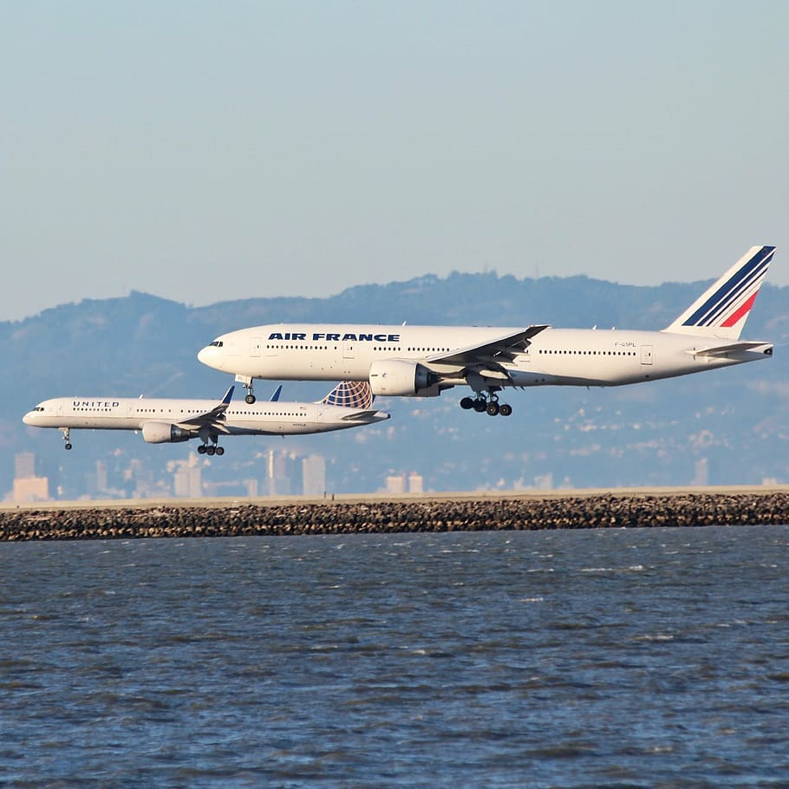
Internet Marketing and The Search For Optimization
Team 7
Adegoke Ajisafe
Larissa
Max Gu
Rohit Rathee
Jaeah Choi

Slide 2
Overview
Airline Industry Marketing Trends
Competition
Key Performance Indicators
Current Marketing Mix and Insights
Recommendations

Slide 3
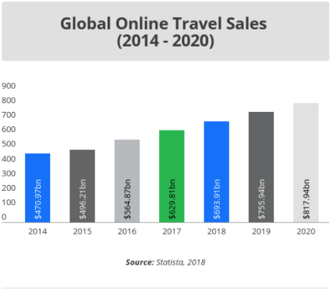
Airline Industry Trends
82%
of travel booking done online
72%
book online in 48 hours after research
15.4%
Online Sale Growth
Annually
70%
Customers research on mobile
https://www.stratosjets.com/blog/online-travel-statistics/#:~:text=The%20process%20of%20online%20travel,market%20shares%20in%20the%20sector.

Slide 4


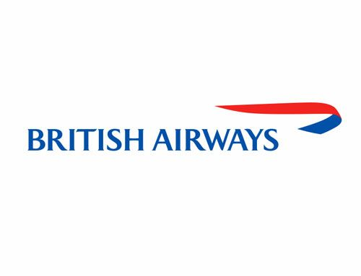



Competition
More Passengers
Less Expensive
More Expensive
Less Passengers

Slide 5
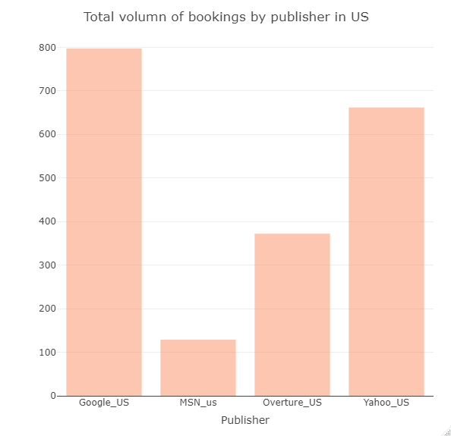
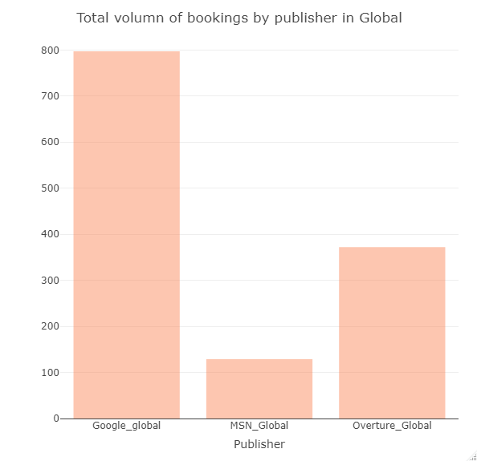
Search Engine Marketing
Performance

Slide 6
Key Performance Indicators
Return on advertising (ROA)
Conversion Rate
Revenue per Booking
Cost per Click
Probability of booking
Increase ticket sales
Optimize market channel selection
Optimize campaign performance

Slide 7
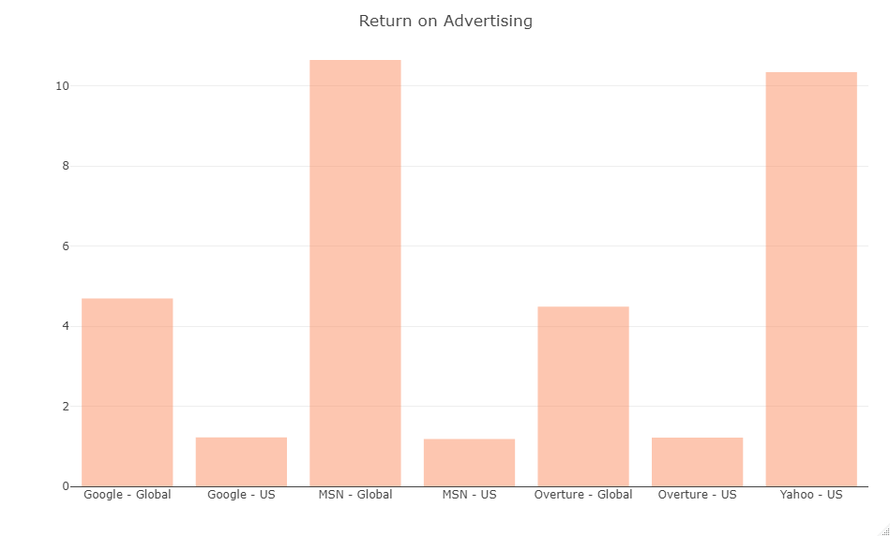
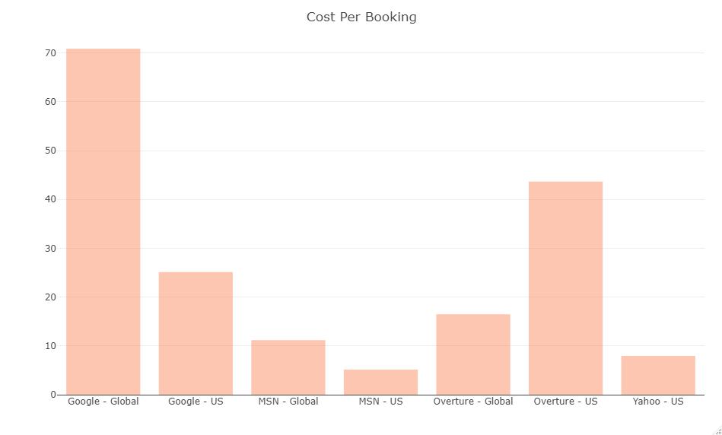
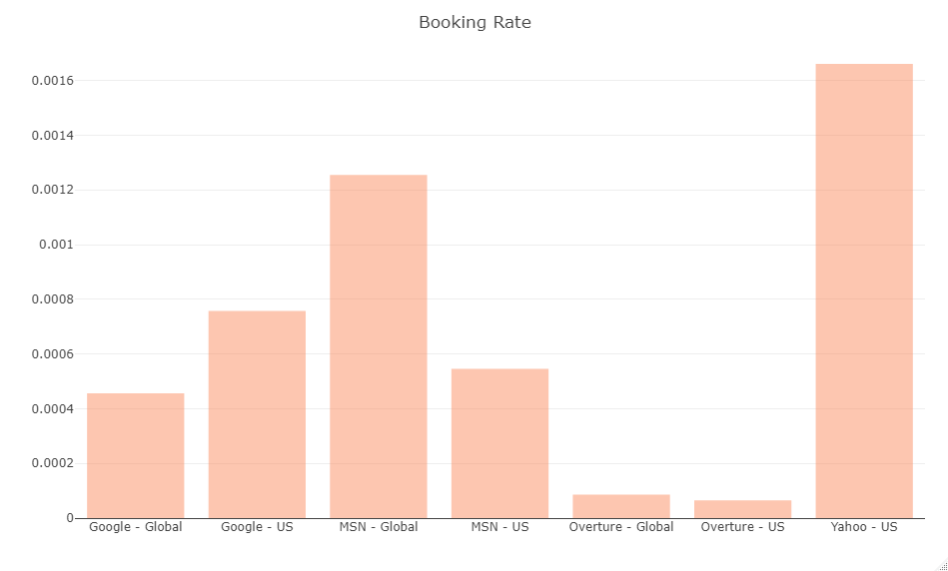
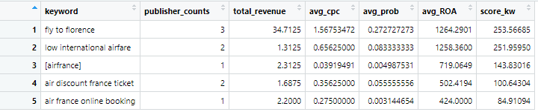
Search Publisher Comparison

Slide 8
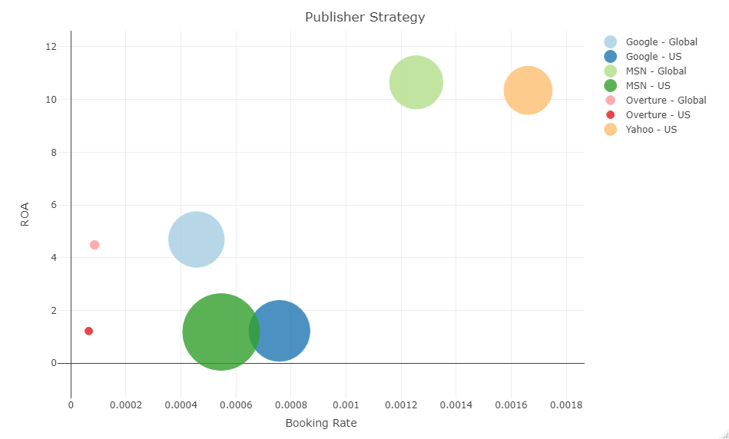
Publisher ROA Comparison
Google is most expensive ,consumes majority of budget with average rate of success.
Yahoo has the highest conversion rate.
MSN has highest Return on Advertisement for global markets.
Overture has the least chance of booking success

Slide 9
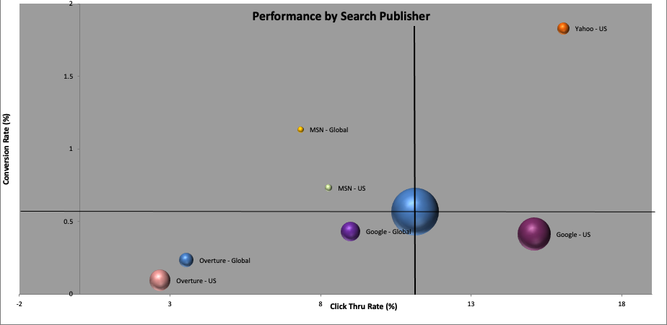
Publisher Efficiency Comparison
Google provides good web visibility with a good conversion rate
Yahoo is best investment value for money
MSN has good conversion rate and promising potential
Overture is least performing with unqualified traffic

Slide 10
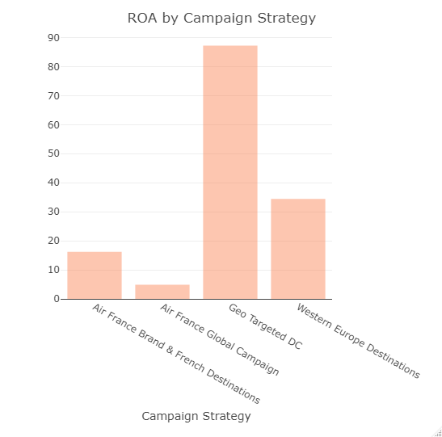
Campaign Efficiency Comparison
Geo-targeted campaigns with location are the most profitable(ex: “Geotargeted DC”)
Branded campaigns with destination (ex: Air France Brand & French Destination)
Regional campaigns (Western Europe)also give good return on advertisement

Slide 11
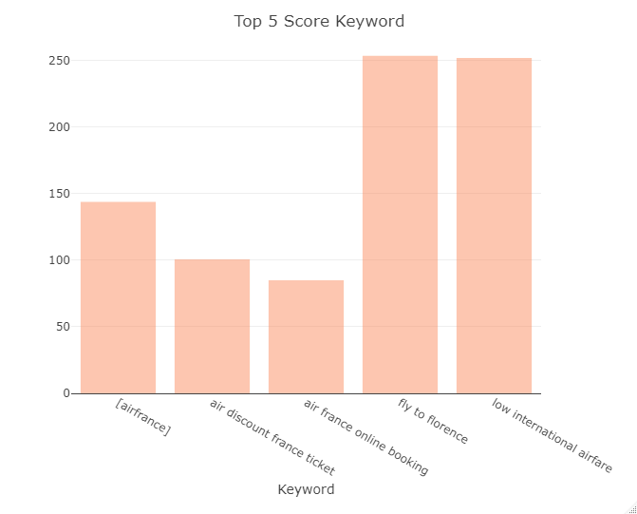
Keyword Efficiency Comparison
Destination-specific keywords are the most profitable (ex: “fly to Florence”)
Bargain related keywords (ex: “low international airfare”)
Branded exact keywords also give good return on advertisement(ex: Air France)

Slide 12
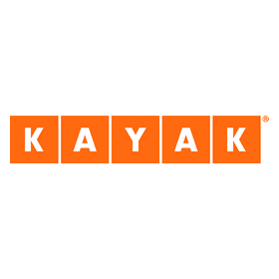
Metasearch Insights
Kayak is essential
Lower costs, better results
Capture bargain seeking customers
Diversify marketing spend

Slide 13
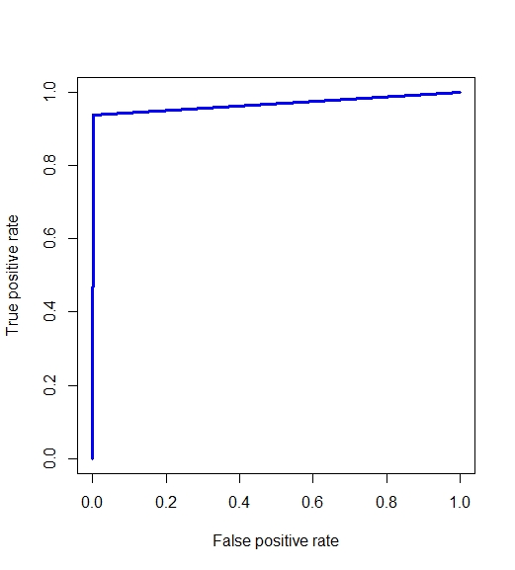
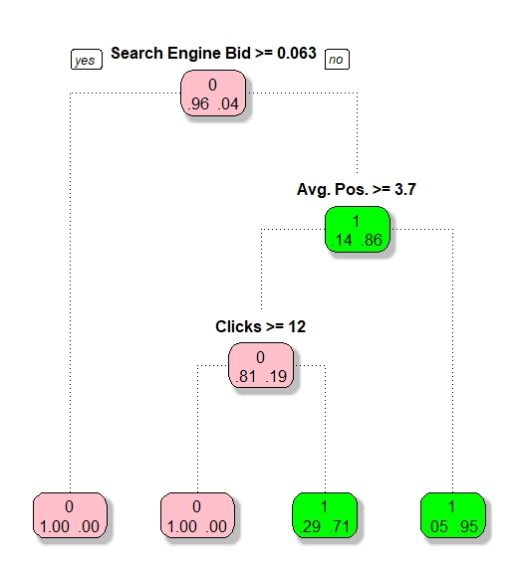
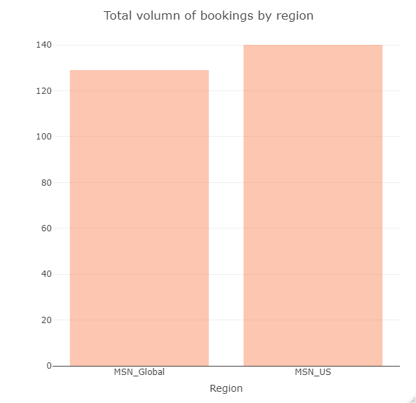
Statistical Insights - MSN
Search Engine Bid < 0.063, Avg.pos < 3.7 lead to 95% of Odds of success.
Search Engine Bid < 0.063, Avg.pos >= 3.7, clicks<12 leads to 71% of Odds of success.

Slide 14
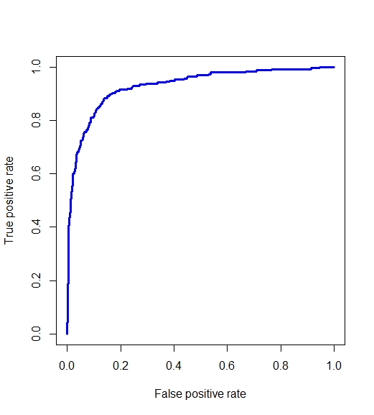
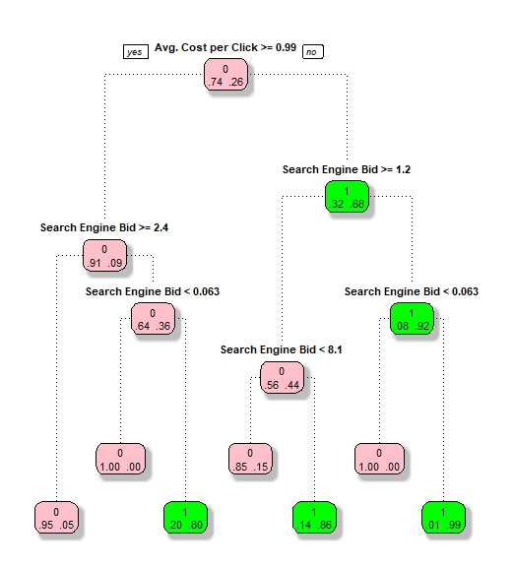
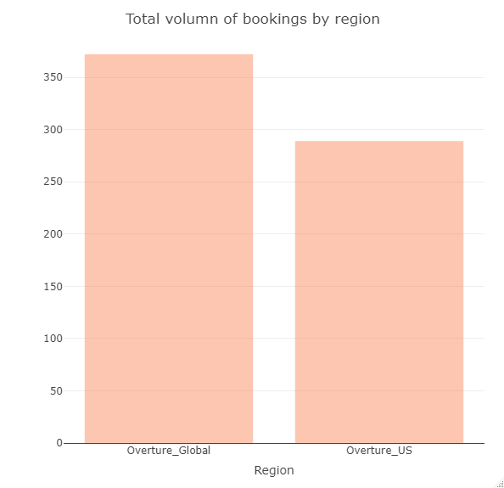
Statistical Insights- Overture
Avg.Cost per Click < 0.99, Search Engine Bid <0.063 lead to 99% of Odds of success.
Avg.Cost per Click < 0.99, Search Engine Bid >=8.1 lead to 86% of Odds of success.
Avg.Cost per Click >= 0.99, 0.063<=Search Engine Bid <2.4 lead to 80% of Odd of success.

Slide 15
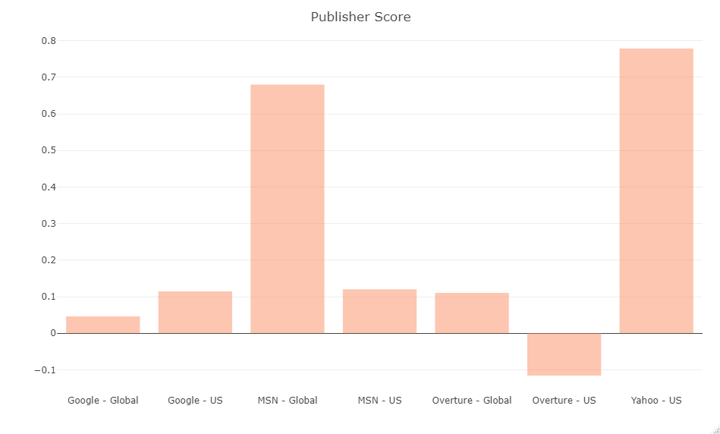
Recommendations
Invest more of budget into MSN for global marketing and Yahoo for US market.
Maintain strong investment in branding and bargain related keywords (ex: “low international fare”)
Diversify more into Metasearch (Kayak) to capture bargain focused customers & trend.
Improve pricing policy and user experience on mobile app.

Slide 16
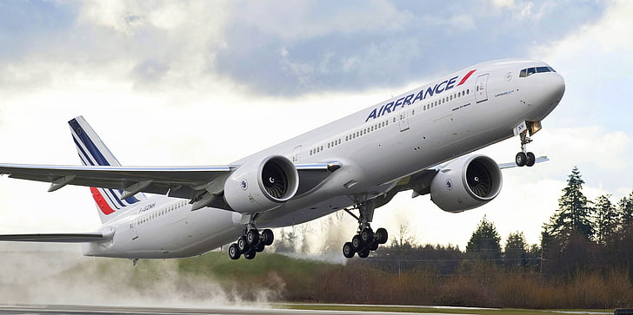
Thank you for your patronage!

Slide 17
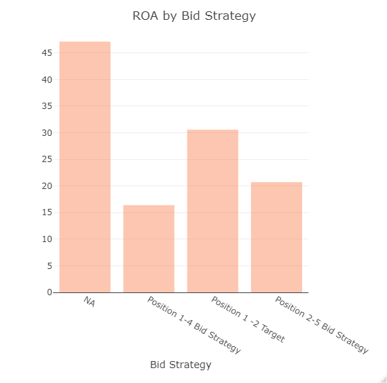
Appendix
Figure 1: Return on Advertisement by Bid strategy

Slide 18
Appendix
Table 1: Pivot table for Keyword variable

Slide 19
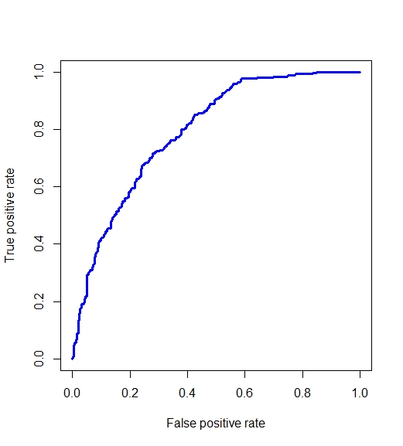
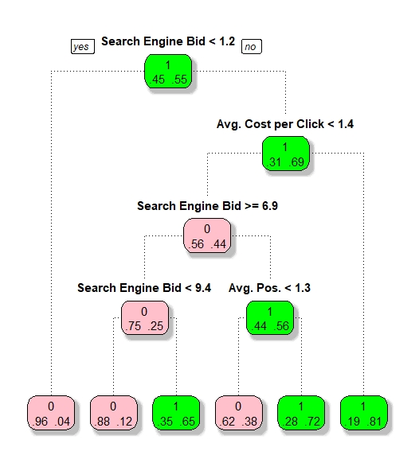
Statistical Insights- Google
Average cost per click >1.4
Average. Pos >1.3 lead to at least 72% odds of success.
Figure 2: Decision tree for Google
Figure 3: AUC/ROC for Google

Slide 20
Objectives
Determine if Air France needs a uniform or tailored strategy for search engines
Evaluate search engine KPIs, bid strategy, keywords and groups
What will increase ticket sales and improve ROA?
Which search engine delivered the most value to Air France?
Potential future strategies Media Contacts should consider for increasing market share and profitability.

Slide 21
Overview
Airline Industry Trends: Uniform or tailored strategy for search engines
Marketing Mix: Evaluate search engine KPIs, bid strategy, keywords and groups
Marketing channels and Strategy: What will increase ticket sales and improve ROA?
Which search engine delivered the most value to Air France?
Key performance indicators FOR optimization potential
Recommendations Future strategies Media Contacts should consider for increasing market share and profitability.

Slide 22
THANK YOU!

Slide 23
REFERENCES
Charlton, G. (2020, December 17). Digital Trends in the Travel Industry: 12 Fascinating Stats. Retrieved December 18, 2020, from https://www.salecycle.com/blog/featured/digital-trends-travel-industry-12-fascinating-stats/
Deane, S. (2020, September 24). Over 60 Online Travel Booking Statistics (2020). Retrieved December 18, 2020, from https://www.stratosjets.com/blog/online-travel-statistics/
.

